Slide 1
Polypharmacology in CNS diseases
Presented By: Umesh Thapa

Slide 2
Overview
Central Nervous System Diseases
Polypharmacology
Multitarget CNS drugs
Blood Brain Barrier Challenge
Multitarget Designed Ligands(MTDLs)
MTDLs Potentials
Conclusion

Slide 3
Central Nervous System Diseases
Neurodegenerative disorders are often:
  Polygenic
  Complex networks of proteins
  Involve interaction of neurotransmitters
Thus, polypharmacology can be a novel approach.

Slide 4
Polypharmacology
Involves multitarget drug design which will be able to:
modulate group of targets.
reduce off-target interactions.
Such designed drugs act on both cholinergic and monoaminergic systems to retard neurodegeneration.

Slide 5
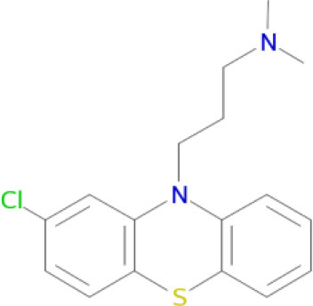
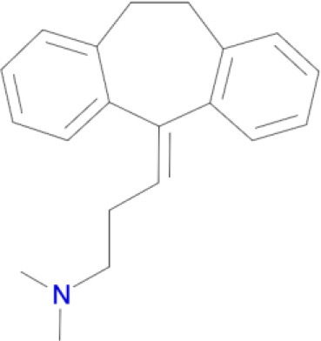
Multitarget CNS drugs
It has targets like D₁ , D₅ , D₃ D₂, D_{4,} 5-HT_{2a} receptors
Chloropormazine
Its target are D₁, D_{5,} D₂, D₃ , , H₁ receptors
D₁₋₅ are dopamine receptors , HT are seretonin receptors and H1 are histamine receptors.
Amitriptyline

Slide 6
Blood Brain Barrier Challenge:
Higher lipophilicity causes increased metabolic and toxicity risk.(due to decreased solubility)
Reducing Hydrogen Bond Donor count of a molecule increases unbound drug brain concentrations.

Slide 7
For Optimal Brain Exposure
Topological Polar Surface Area < 60 Å2, and HBD count < 2 are minimizing P-Glycoprotein recognition
Molecular Weight < 450; cLogP < 5;HBD < 3; Rotatable Bonds < 8;. → ↑Blood Brain Barrier penetration
HBD, Hydrogen bond donor; cLogP, partition coefficient

Slide 8
Multi-Target Designed Ligands(MTDL)
MTDL modulate group of desired targets:
  Minimize off-target interactions
  Avoid anti-target inerations
MTDL contains:
  Primary pharmacophore for each target
  Either separated by linker OR
  Touch at point using commonalities in structures

Slide 9
Multi-Target Designed Ligands
Hybrid compound M30D contains pharmacohores from drugs: rivastigmine (ChEIs) and Ladostigil (MAO – B inhibitior)
Similarly ASS234 and MBA236 contain pharmacophores of donezpil (ChEIs) and clorgiline ( MAO – A inbibitor)

Slide 10
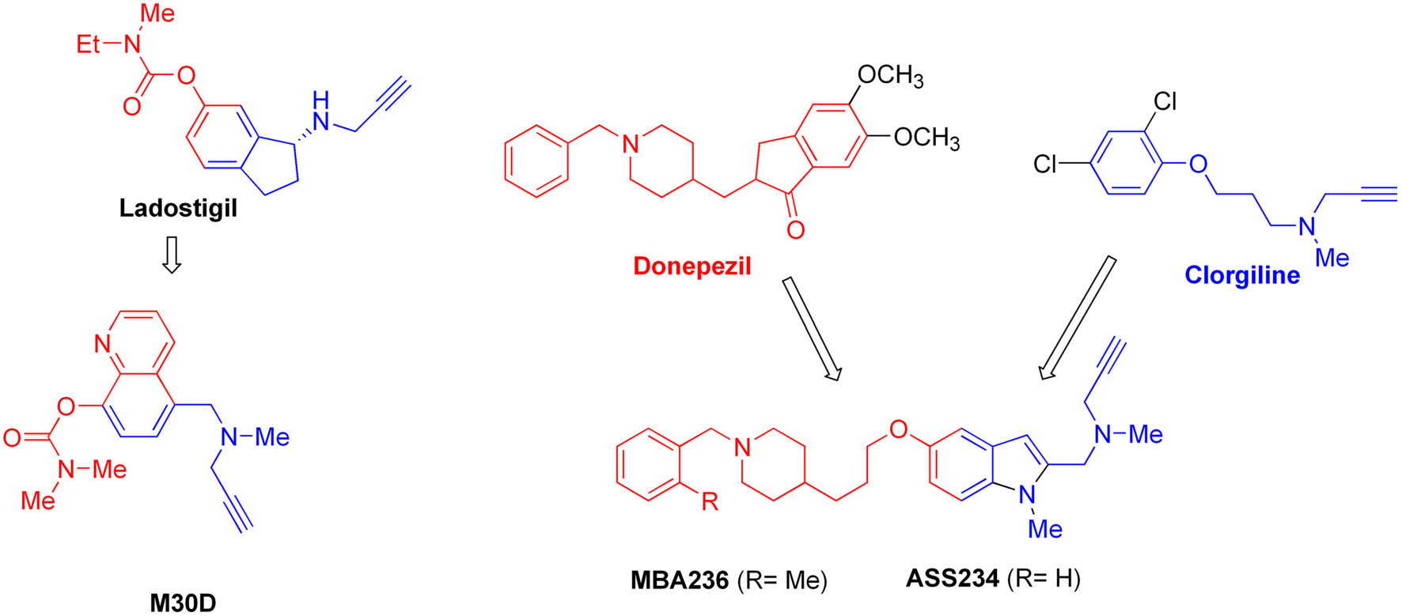
Multi-Target Designed Ligands

Slide 11
MTDLs Potentials
The propargylamine moiety used as the main chemical scaffold for MAO inhibition in the designed M30D, ASS234 and MBA 236 hybrids.
ASS234 found to be 54-fold more potent MAO-B inhibitor than clorgiline.
MBA236 is SIX times more potent as MAO-B inhibitor than ASS234

Slide 12
MTDLs Potentials
M30D found to be highly potent inhibitor of MAO – A and also potent AChE inhibitor than rivastigmine.
However, inhibition of ChEIs hybrid compound is found to be not significantly potent than parent drugs.

Slide 13
Conclusion
Multitarget inhibitors of acetylcholine esterase and MAO were found to be effective drug candidates for Alzheimer’s and Parkinson’s diseases.

Slide 14
References
Anighoro A., Bajorath J., and Rastelli G., (2014) Polypharmacology: Challenges and Oppurtunities in Drug Discovery. J . Med. Chem. 57, 7874 – 7887. doi: 10.1021/jm 5006463
Nikolic K., Mavridis L., Djikic T., Vucicevic J., Agbaba K.Y., and Mitchell J.B.O.(2016). Drug Design for CNS Diseases: Polypharmacological Profiling of Compounds Using Cheminformatic, 3D-QSAR and Virtual Screening Methodologies. Frontiers in Neuroscience. 10, Article 265.
Alelyunas, Y. W., Empfield, J. R., McCarthy, D., Spreen, R.C., Bui, K., Pelosi- Kilby, L.,etal.(2010).Experimental solubility profiling of marketed CNS drugs, exploring solubility limit of CNS discovery candidate. Bioorg. Med. Chem. Lett. 20, 73127316. doi:10.1016/ j.bmcl.2010.10.068

Slide 15
THANK YOU

